Slide 1

A STUDY ON THE GROCERY BUYING BEHAVIOUR AMONG THE PEOPLE OF HYDERABAD

Slide 2

INTRODUCTION
“Consumer Commerce is the future. Bricks and mortar will remain an important channel although we know channel agnostic and customer centric is key and the competition will be much broader than today’s retail.” - Paul Martin, KPMG.

Slide 3

Objectives of the study
To understand the history of grocery purchase among Indians.
To evaluate the offline buying preferences of shoppers in the organised & unorganised sector.
To evaluate the online buying preferences of shoppers and study its different dimensions.
To highlight the influence of demographic factors on consumer preference based on attributes like product quality, packaging, promotion, discounts and time that heavily influence consumer behaviour.
To identify the most preferred platform for online grocery shopping.
To study the change in the online grocery purchase prior and during the COVID-19 pandemic.

Slide 4
Methodology
Sample of 200 people was taken from various sectors
Bar Graph
Pie Chart
Frequency tables
Chi-square tests
Sample
Design
Source of Data
Diagrammatic Representation
Data Collection
Data Analysis
Primary data
Questionnaire
Personal Interview

Slide 5
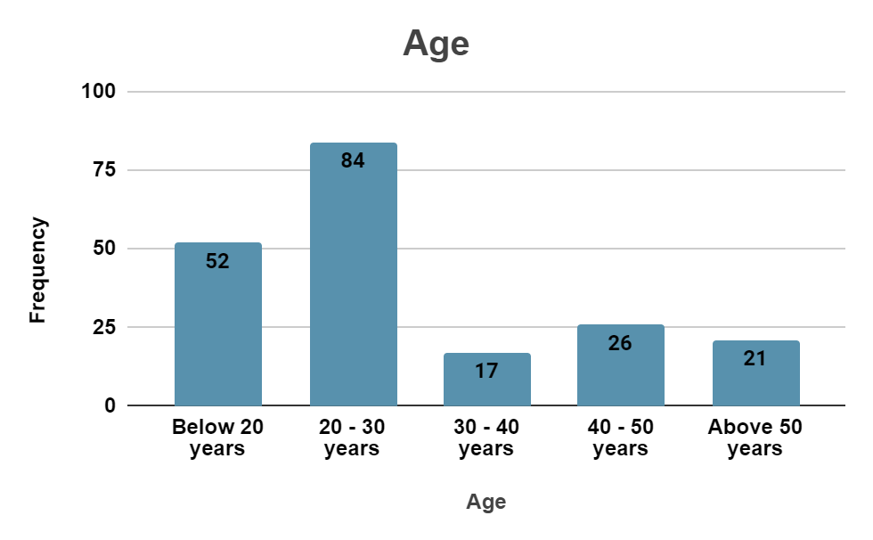
Demographics
Gender
Female
Age
58%
42%
Male
85%
25%
42%
8.5%
13%
10.5%
Below 20 years
20-30 years
30-40 years
40-50 years
Above 50 years

Slide 6
Demographics
Highest level of education
Occupation
Retired
House wife
Bachelor’s Degree
4.5%
8.5%
Self Employed
11%
Master’s Degree
26%
53.5%
High School
22.5%
74%
PHD/ MPhil
Employee
Student
21%
55%
21.5%
2.5%

Slide 7
Family Annual Income
34.5%
24.5%
23%
18.5%
Upto 3,00,000
3,00,000 to 5,00,000
5,00,000 to 10,00,000
10,00,000 and above

Slide 8
Grocery Retail in India
Organised sector
Unorganised sector
Supermarkets
Online Grocery Stores
Local Stores
Street Vendors

Slide 9






SUPERMARKETS

Slide 10
What is your most preferred supermarket?
6.5%
17.5%
8%
44%
7%
6%
Jio Mart
Ratnadeep
More Megastore
D Mart
BigBazaar
Heritage Fresh

Slide 11
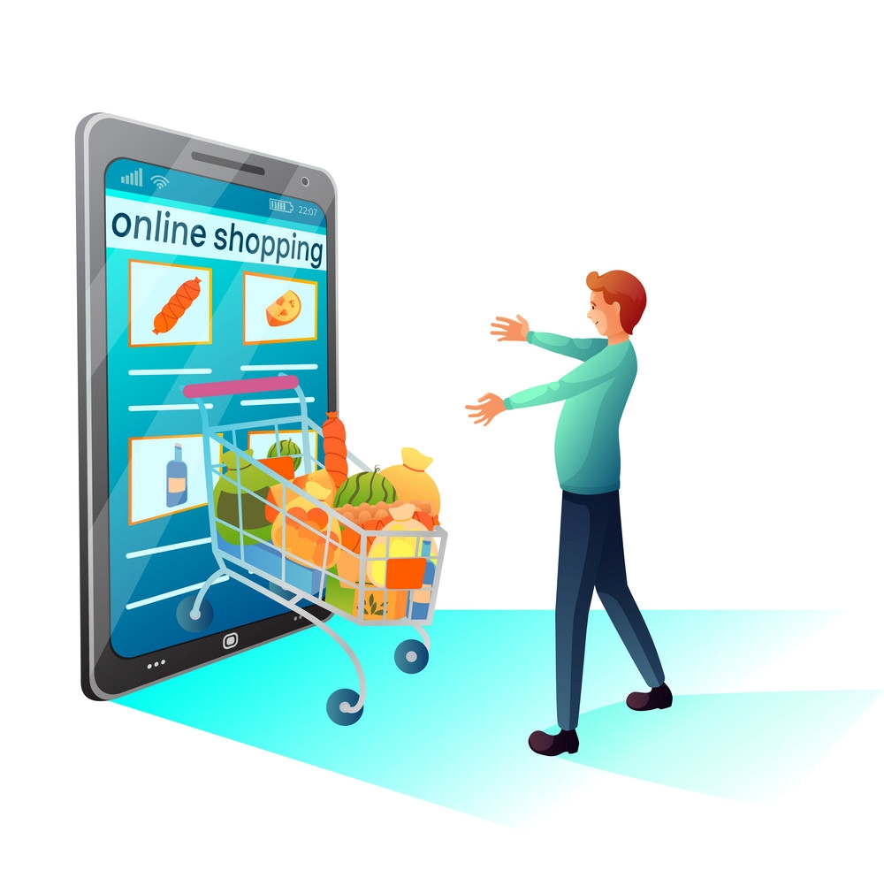
Have you shopped for groceries online at least once?
No
26%
74%
Yes

Slide 12





ONLINE GROCERY APPS

Slide 13
What is your most preferred app for online grocery shopping?
5.5%
17.5%
9.5%
24.5%
8%
Jio Mart
Amazon
Grofers
BigBasket
Swiggy Instamart

Slide 14
Why do people prefer shopping online?
Wide variety of products
Quick & Efficient delivery
Good discounts
It is convenient
40.5%
35.5%
41.5%
51.5%

Slide 15
What do you think primarily prevents people from shopping online?
53%
50.5%
48.5%
24%
Lack of awareness
Risk of online fraud
Uncomfortable with technology
Risk of identity theft

Slide 16
Have you ever encountered challenges while shopping online?
62%
38%
of the respondents encountered challenges while shopping online.
of the respondents didn’t encounter any challenges while shopping online.

Slide 17
Problems faced by people while shopping online
44%
Unavailability of products post ordering
29%
Transaction issues
Return issues
23%
22%
Refund issues

Slide 18
With prompt delivery, would people still prefer Online Grocery Shopping with a 10-20% increase in the total price?
Yes
7.5%
Maybe
23.5%
No
48.5%

Slide 19
With good discounts, would people still prefer Online Grocery Shopping if the delivery is delayed?
Yes
22.5%
Maybe
33%
No
34.5%

Slide 20
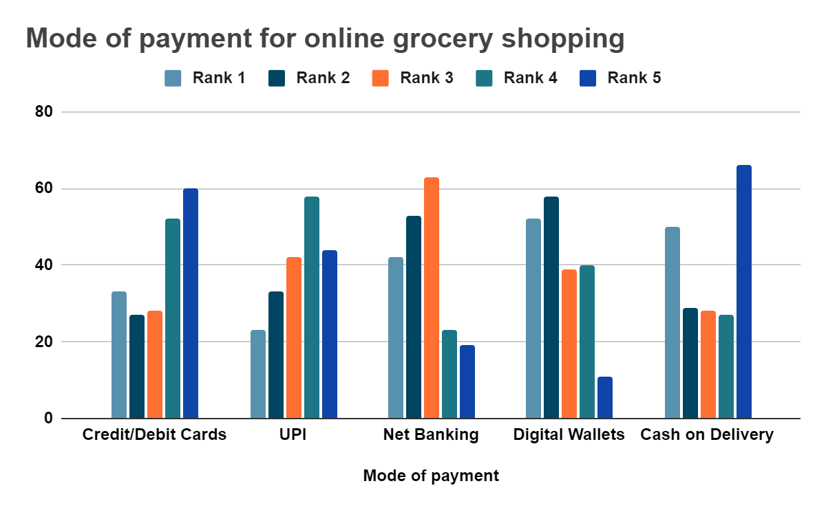
Ranking modes of payment people use while shopping for
groceries online from most to least frequently
The results show the following rank ordering:
1. Credit/Debit Cards
2. UPI
3. Cash on Delivery
4. Net Banking
5. Digital Wallets

Slide 21
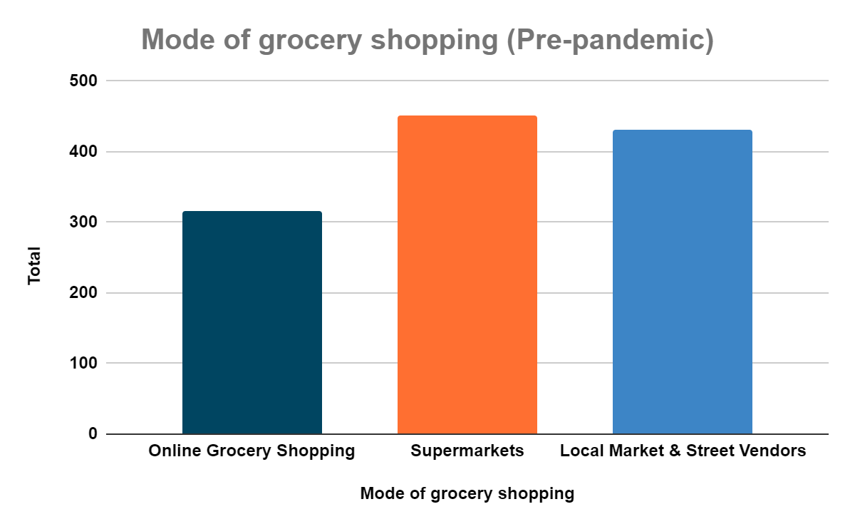
Ranking the most preferred mode of grocery shopping Pre-Pandemic
The results show the following rank ordering:
1. Supermarkets
2. Local stores & Street vendors
3. Online Grocery Shopping

Slide 22
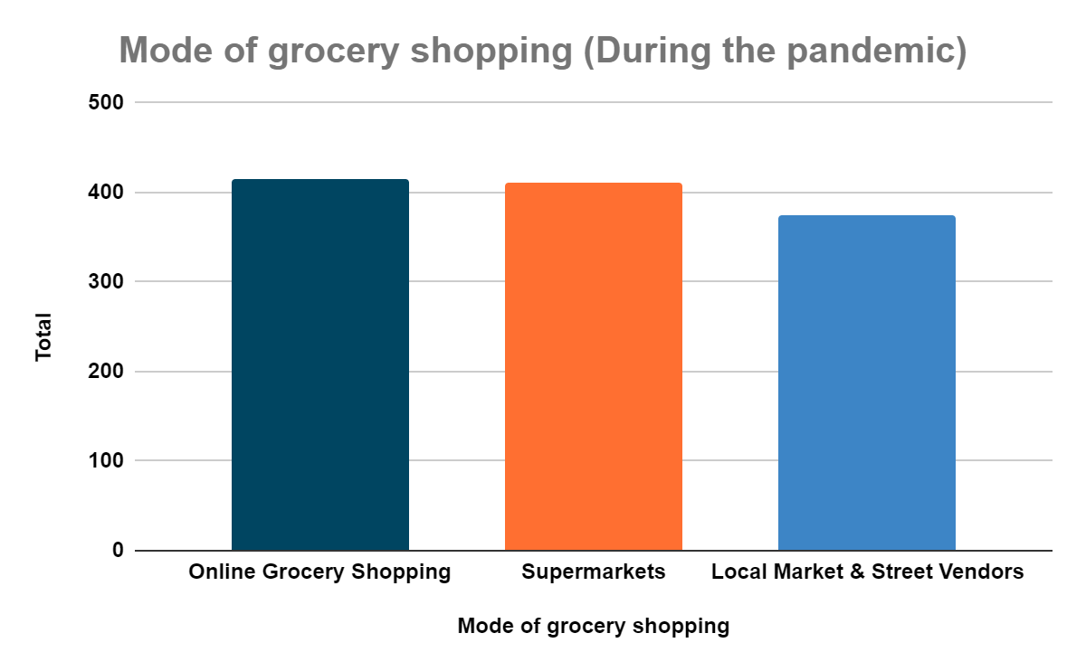
Ranking the most preferred mode of grocery shopping during the Pandemic
The results show the following rank ordering:
1. Online Grocery Shopping
2. Supermarkets
3. Local stores & Street vendors

Slide 23
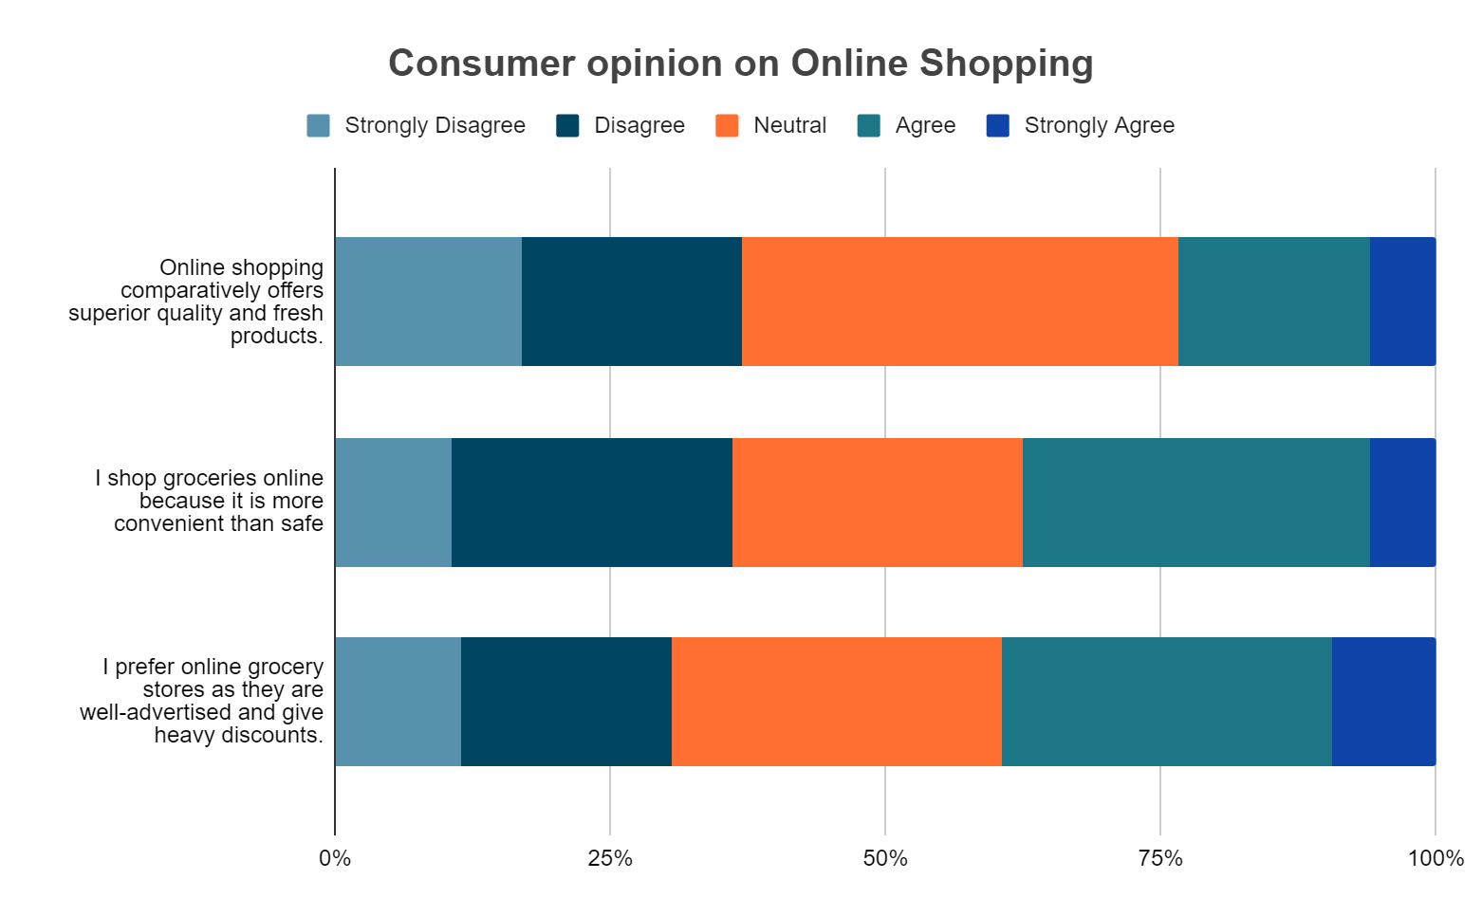
37%
Mean = 2.76
Std, Deviation = 1.114
56%
37.5%
Mean = 2.97
Std, Deviation = 1.111
39.5%
Mean = 3.07
Std, Deviation = 1.154

Slide 24
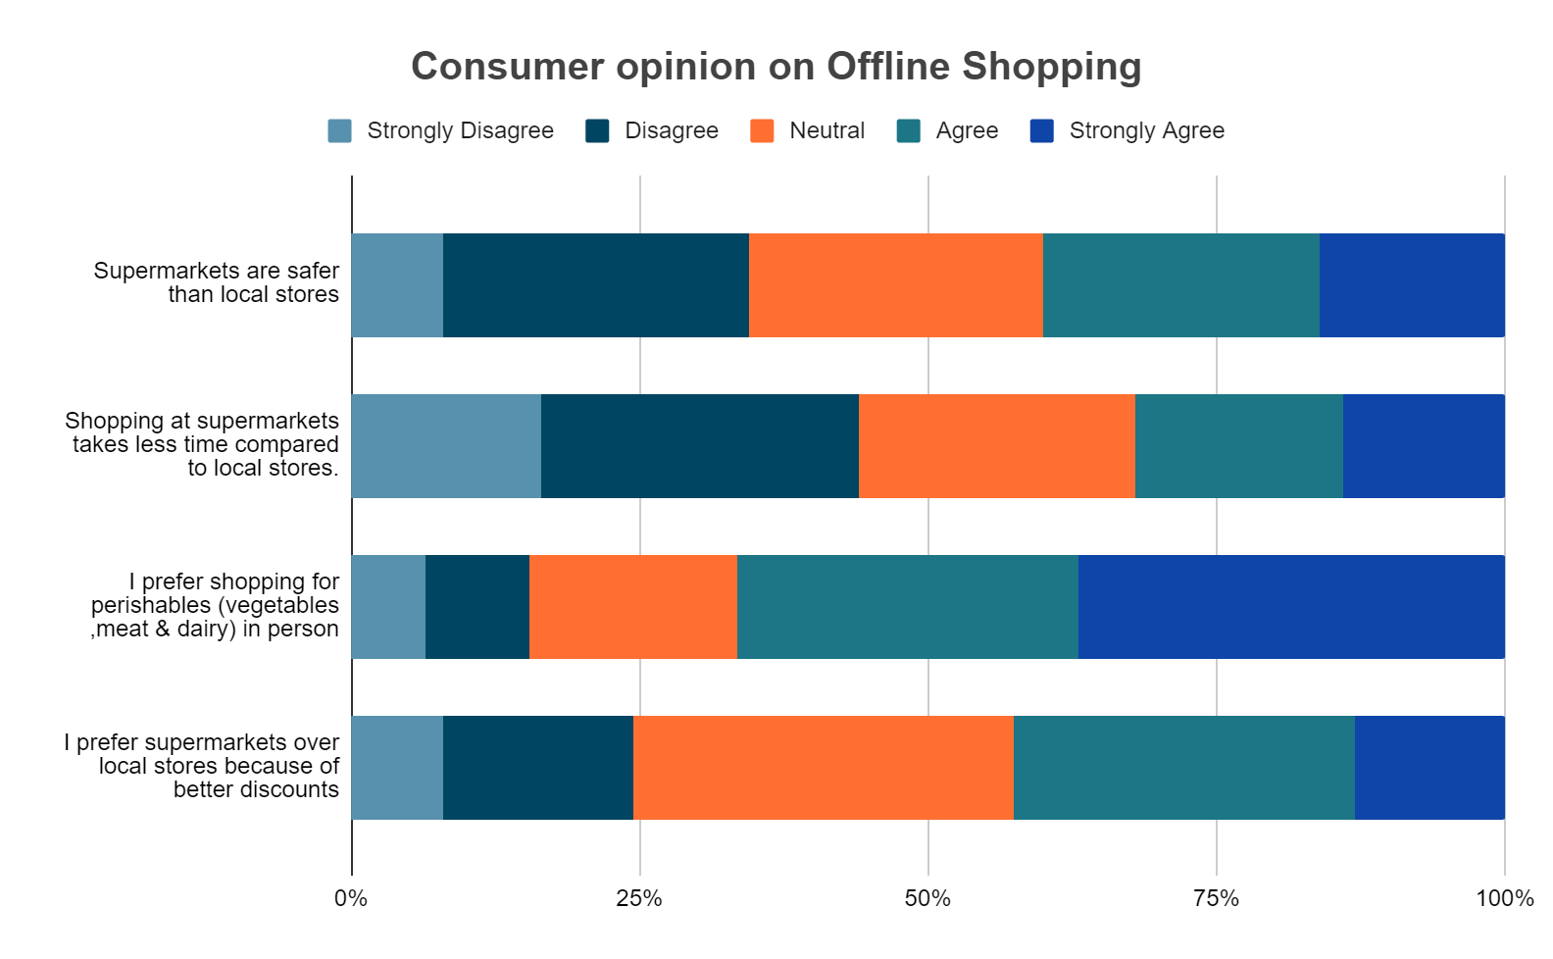
40%
Mean = 3.13
Std, Deviation = 1.206
44%
Mean = 2.85
Std, Deviation = 1.289
66.5%
Mean = 3.81
Std, Deviation = 1.212
42%
Mean = 3.23
Std, Deviation = 1.12

Slide 25
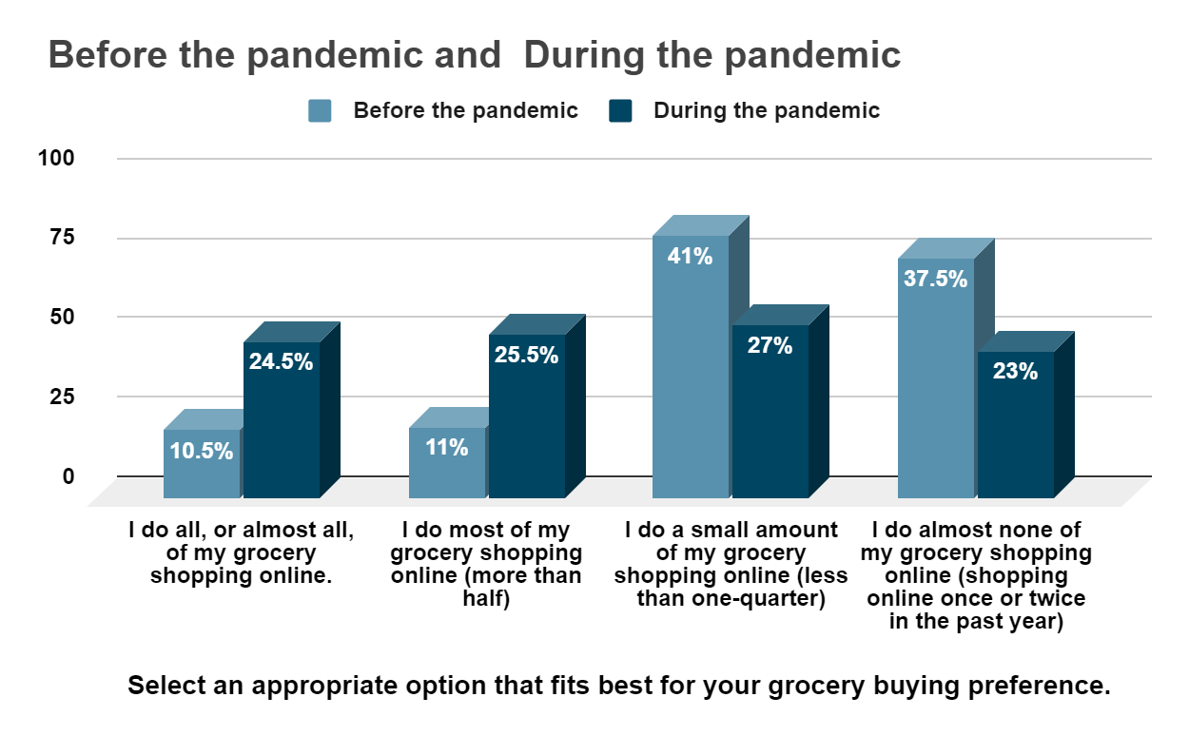
Online Grocery Shopping-Estimate Pre and During the Pandemic

Slide 26
How likely are you to purchase groceries online post-pandemic?
Very unlikely
Very likely
18%
10%
Likely
Unlikely
17%
34.5%

Slide 27
Null Hypothesis (H₀)
Chi-Square Test
There is no association between the two variables.
Alternative Hypothesis (H₁)
There is an association between the two variables.
Chi-square Test
Pearson's chi-squared test is used to determine whether there is a statistically significant difference between the expected frequencies and the observed frequencies in one or more categories of a contingency table.

Slide 28
Age * What is your most preferred mode of offline grocery shopping?
Age * What is your most preferred mode of offline grocery shopping?
 |  | What is your most preferred mode of offline grocery shopping? |  | Total
 |  | Supermarkets | Local Stores & Vendors
Age | Below 20 years | 33 | 19 | 52
 | 20 - 30 years | 48 | 36 | 84
 | 30 - 40 years | 9 | 8 | 17
 | 40 - 50 years | 16 | 10 | 26
 | Above 50 years | 12 | 9 | 21
Total |  | 118 | 82 | 200
CONCLUSION :
From the above table, we observe that the value of p > 0.05 i.e.,(0.924 > 0.05).
Therefore, we accept the Null Hypothesis and conclude that there is no association between the age of a consumer and their most preferred mode of offline grocery shopping.

Slide 29
How often do you shop for groceries offline? * Gender
How often do you shop for groceries offline? * Gender
 |  | Gender |  | Total
 |  | Female | Male
How often do you shop for groceries offline? | Once a week | 31 | 32 | 63
 | Once a month | 35 | 19 | 54
 | Few times in a month | 44 | 28 | 72
 | Other | 4 | 4 | 8
 | Never | 2 | 1 | 3
Total |  | 116 | 84 | 200
CONCLUSION :
From the above table, we observe that the value of p > 0.05 i.e.,(0.460 > 0.05).
Therefore, we accept the Null Hypothesis and conclude that there is no association between people’s gender and how often they shop for groceries offline.

Slide 30
Age * What is your most preferred app for online grocery shopping?
Age * What is your most preferred app for online grocery shopping?
 |  | What is your most preferred app for online grocery shopping? |  |  |  |  |  |  | Total
 |  | Big Basket | Grofers | Amazon | Swiggy Instamart | Jio Mart | Others | None
Age | Below 20 years | 10 | 0 | 9 | 2 | 8 | 5 | 18 | 52
 | 20 - 30 years | 25 | 4 | 17 | 6 | 4 | 12 | 16 | 84
 | 30 - 40 years | 3 | 4 | 2 | 4 | 0 | 0 | 4 | 17
 | 40 - 50 years | 8 | 3 | 5 | 2 | 1 | 1 | 6 | 26
 | Above 50 years | 3 | 0 | 2 | 2 | 6 | 0 | 8 | 21
Total |  | 49 | 11 | 35 | 16 | 19 | 18 | 52 | 200
CONCLUSION :
From the above table, we observe that the value of p < 0.05 i.e.,(0.001 < 0.05).
Thus, we reject the Null Hypothesis. As a result, we accept Alternate Hypothesis and conclude that there is an association difference between people’s age and their most preferred app for online grocery shopping.

Slide 31
Family annual income * How often do you shop for groceries online?
Family annual income * How often do you shop for groceries online?
 |  | How often do you shop for groceries online? |  |  |  |  | Total
 |  | Once a week | Once a month | Few times in a month | Other | Never
Family annual income | Upto 3,00,000 | 1 | 18 | 18 | 7 | 24 | 68
 | 3,00,000 to 5,00,000 | 4 | 5 | 17 | 6 | 14 | 46
 | 5,00,000 to 10,00,000 | 4 | 10 | 12 | 7 | 16 | 49
 | 10,00,000 and above | 4 | 7 | 14 | 6 | 6 | 37
Total |  | 13 | 40 | 61 | 26 | 60 | 200
CONCLUSION :
From the above table, we observe that the value of p > 0.05 i.e.,( 0.322 > 0.05). Therefore, we accept the Null Hypothesis and conclude that there is no association between the consumer’s family income and how often they shop for groceries online.

Slide 32
Highest level of education * _UNCOMFORTABLE WITH TECHNOLOGY.
Highest level of education * _UNCOMFORTABLE WITH TECHNOLOGY
 |  | _UNCOMFORTABLE WITH TECHNOLOGY |  | Total
 |  | Selected | Not Selected
Highest level of education | High school | 24 | 18 | 42
 | Bachelor’s Degree | 49 | 61 | 110
 | Master’s Degree | 21 | 22 | 43
 | PHD/ MPhil | 3 | 2 | 5
Total |  | 97 | 103 | 200
CONCLUSION :
From the above table, we observe that the value of p > 0.05 i.e.,(0.530 > 0.05).
Therefore, we accept the Null Hypothesis and conclude that there is no association between a consumer’s highest level of education and discomfort with technology.

Slide 33
When did you start online grocery shopping? * Have you ever encountered challenges while shopping online (like transaction failures and unavailability of products post ordering)?
When did you start online grocery shopping? * Have you ever encountered challenges while shopping online (like transaction failures and unavailability of products post ordering) ?
 |  | Have you ever encountered challenges while shopping online (like transaction failures and unavailability of products post ordering)? |  | Total
 |  | Yes | No
When did you start online grocery shopping? | Before 2016 | 9 | 1 | 10
 | 2016-17 | 13 | 2 | 15
 | 2017-18 | 16 | 4 | 20
 | 2018-19 | 20 | 9 | 29
 | During the pandemic | 51 | 23 | 74
 | Not Applicable | 15 | 37 | 52
Total |  | 124 | 76 | 200
CONCLUSION :
From the above table, we observe that the value of p < 0.05 i.e.,( 0.000 < 0.05). Thus, we reject the Null Hypothesis and conclude that there is an association between when a consumer began online grocery shopping and them encountering issues while shopping online.

Slide 34
What is your most preferred mode of offline grocery shopping? * Shopping
at supermarkets takes less time compared to local stores.
What is your most preferred mode of offline grocery shopping? * Shopping at supermarkets takes less time compared to local stores.
 |  | Shopping at supermarkets takes less time compared to local stores. |  |  |  |  | Total
 |  | Strongly Disagree | Disagree | Neutral | Agree | Strongly Agree
What is your most preferred mode of offline grocery shopping? | Supermarkets | 18 | 34 | 28 | 20 | 18 | 118
 | Local Stores & Vendors | 15 | 21 | 20 | 16 | 10 | 82
Total |  | 33 | 55 | 48 | 36 | 28 | 200
CONCLUSION :
From the above table, we observe that the value of p > 0.05 i.e.,( 0.916 > 0.05). Therefore, we accept the Null Hypothesis and conclude that there is no association between a consumer’s most preferred mode of offline grocery shopping and the claim that shopping at supermarkets takes less time compared to local stores.

Slide 35
Family annual income * With prompt delivery, would you still prefer Online
Grocery Shopping with a 10-20% increase in the total price?
Family annual income * With prompt delivery, would you still prefer Online Grocery Shopping with a 10-20% increase in the total price?
 |  | With prompt delivery, would you still prefer Online Grocery Shopping with a 10-20% increase in the total price? |  |  |  | Total
 |  | Yes | Maybe | Can't say | No
Family annual income | Upto 3,00,000 | 8 | 19 | 15 | 26 | 68
 | 3,00,000 to 5,00,000 | 1 | 8 | 12 | 25 | 46
 | 5,00,000 to 10,00,000 | 3 | 10 | 11 | 25 | 49
 | 10,00,000 and above | 3 | 10 | 3 | 21 | 37
Total |  | 15 | 47 | 41 | 97 | 200
CONCLUSION :
From the above table, we observe that the value of p > 0.05 i.e.,( 0.278 > 0.05). Therefore, we accept the Null Hypothesis and conclude that there is no association between the family income of people and their preference if they would still choose online grocery shopping with a 10-20% increase in the total price.

Slide 36
Occupation * Select an appropriate option that fits best for your grocery
buying preference before the pandemic.
Occupation * Select an appropriate option that fits best for your grocery buying preference before the pandemic.
 |  | Select an appropriate option that fits best for your grocery buying preference before the pandemic. |  |  |  | Total
 |  | I do all, or almost all, of my grocery shopping online. | I do most of my grocery shopping online (more than half) | I do a small amount of my grocery shopping online (less than one-quarter) | I do almost none of my grocery shopping online (shopping online once or twice in the past year)
Occupation | Student | 13 | 12 | 48 | 34 | 107
 | Employee | 6 | 3 | 18 | 18 | 45
 | Self employed | 1 | 3 | 9 | 9 | 22
 | House wife | 1 | 4 | 5 | 7 | 17
 | Retired | 0 | 0 | 2 | 7 | 9
Total |  | 21 | 22 | 82 | 75 | 200
CONCLUSION :
From the above table, we observe that the value of p > 0.05 i.e., ( 0.317 > 0.05). Therefore, we accept the Null Hypothesis and conclude that there is no association between a consumer’s occupation and the amount of grocery they bought online before the onset of the COVID-19 pandemic.

Slide 37
Occupation * Select an appropriate option that fits best for your grocery
buying preference during the pandemic.
Occupation * Select an appropriate option that fits best for your grocery buying preference during the pandemic.
 |  | Select an appropriate option that fits best for your grocery buying preference during the pandemic. |  |  |  | Total
 |  | I do all, or almost all, of my grocery shopping online. | I do most of my grocery shopping online (more than half) | I do a small amount of my grocery shopping online (less than one-quarter) | I do almost none of my grocery shopping online (shopping online once or twice in the past year)
Occupation | Student | 25 | 31 | 28 | 23 | 107
 | Employee | 9 | 12 | 15 | 9 | 45
 | Self employed | 7 | 4 | 5 | 6 | 22
 | House wife | 8 | 3 | 2 | 4 | 17
 | Retired | 0 | 1 | 4 | 4 | 9
Total |  | 49 | 51 | 54 | 46 | 200
CONCLUSION :
From the above table, we observe that the value of p > 0.05 i.e., ( 0.278 > 0.05). Therefore, we accept the Null Hypothesis and conclude that there is no association between a consumer's occupation and the amount of grocery they purchase online during the pandemic.

Slide 38
Family annual income * How likely are you to purchase groceries online post-pandemic?
Family annual income * How likely are you to purchase groceries online post pandemic?
 |  | How likely are you to purchase groceries online post pandemic? |  |  |  |  | Total
 |  | Very unlikely | Unlikely | Neutral | Likely | Very likely
Family annual income | Upto 3,00,000 | 7 | 14 | 13 | 19 | 15 | 68
 | 3,00,000 to 5,00,000 | 6 | 6 | 11 | 19 | 4 | 46
 | 5,00,000 to 10,00,000 | 6 | 7 | 11 | 18 | 7 | 49
 | 10,00,000 and above | 1 | 7 | 6 | 13 | 10 | 37
Total |  | 20 | 34 | 41 | 69 | 36 | 200
CONCLUSION :
From the above table, we observe that the value of p > 0.05 i.e., (0.524 > 0.05).
Therefore, we accept the Null Hypothesis and conclude that there is no association between the annual family income of people and the likelihood of purchasing groceries online post-pandemic.

Slide 39
How likely are you to purchase groceries online post pandemic? * Online
shopping comparatively offers superior quality and fresh products.
How likely are you to purchase groceries online post pandemic? * Online shopping comparatively offers superior quality and fresh products.
 |  | Online shopping comparatively offers superior quality and fresh products. |  |  |  |  | Total
 |  | Strongly Disagree | Disagree | Neutral | Agree | Strongly Agree
How likely are you to purchase groceries online post pandemic? | Very unlikely | 9 | 2 | 5 | 3 | 1 | 20
 | Unlikely | 6 | 12 | 13 | 2 | 1 | 34
 | Neutral | 8 | 9 | 12 | 9 | 3 | 41
 | Likely | 4 | 8 | 38 | 15 | 4 | 69
 | Very likely | 7 | 9 | 11 | 6 | 3 | 36
Total |  | 34 | 40 | 79 | 35 | 12 | 200
CONCLUSION :
From the above table, we observe that the value of p < 0.05 i.e., (0.005 < 0.05). Thus, we reject the Null Hypothesis. As a result, we accept Alternate Hypothesis and conclude that there is an association between the likelihood of purchasing groceries online post-pandemic and the assertion that online shopping comparatively offers superior quality and fresh products.

Slide 40
Age * _QUALITY ISSUES
Age * _QUALITY ISSUES
 |  | _QUALITY ISSUES |  | Total
 |  | Selected | Not Selected
Age | Below 20 years | 0 | 52 | 52
 | 20 - 30 years | 4 | 80 | 84
 | 30 - 40 years | 4 | 13 | 17
 | 40 - 50 years | 1 | 25 | 26
 | Above 50 years | 3 | 18 | 21
Total |  | 12 | 188 | 200
CONCLUSION :
From the above table, we observe that the value of p < 0.05 i.e.,(0.004 < 0.05). Thus, we reject the Null Hypothesis. As a result, we accept Alternate Hypothesis and conclude that there is an association between the age of people and the quality issues of online products.

Slide 41
How likely are you to purchase groceries online post-pandemic? * I shop
groceries online because it is more convenient than safe.
How likely are you to purchase groceries online post pandemic? * I shop groceries online because it is more convenient than safe
 |  | I shop groceries online because it is more convenient than safe |  |  |  |  | Total
 |  | Strongly Disagree | Disagree | Neutral | Agree | Strongly Agree
How likely are you to purchase groceries online post pandemic? | Very unlikely | 7 | 7 | 2 | 4 | 0 | 20
 | Unlikely | 3 | 12 | 12 | 5 | 2 | 34
 | Neutral | 2 | 14 | 15 | 10 | 0 | 41
 | Likely | 3 | 11 | 18 | 31 | 6 | 69
 | Very likely | 6 | 7 | 6 | 13 | 4 | 36
Total |  | 21 | 51 | 53 | 63 | 12 | 200
CONCLUSION :
From the above table, we observe that the value of p < 0.05 i.e., (0 < 0.05). Thus, we reject the Null Hypothesis. As a result, we accept Alternate Hypothesis and conclude that there is an association between the likelihood of purchasing groceries online post-pandemic and the assertion that online shopping is comparatively more convenient than safe.

Slide 42
How likely are you to purchase groceries online post-pandemic? * I prefer
online grocery stores as they are well-advertised and give heavy discounts.
How likely are you to purchase groceries online post pandemic? * I prefer online grocery stores as they are well-advertised and give heavy discounts.
 |  | I prefer online grocery stores as they are well-advertised and give heavy discounts. |  |  |  |  | Total
 |  | Strongly Disagree | Disagree | Neutral | Agree | Strongly Agree
How likely are you to purchase groceries online post pandemic? | Very unlikely | 8 | 6 | 5 | 1 | 0 | 20
 | Unlikely | 4 | 11 | 12 | 5 | 2 | 34
 | Neutral | 5 | 9 | 9 | 14 | 4 | 41
 | Likely | 3 | 10 | 19 | 29 | 8 | 69
 | Very likely | 3 | 2 | 15 | 11 | 5 | 36
Total |  | 23 | 38 | 60 | 60 | 19 | 200
CONCLUSION :
From the above table, we observe that the value of p < 0.05 i.e., (0 < 0.05). Thus, we reject the Null Hypothesis. As a result, we accept Alternate Hypothesis and conclude that there is an association between the likelihood of purchasing groceries online post-pandemic and the assertion that online stores are well-advertised and give heavy discounts.

Slide 43

CONCLUSIONS
Majority of the respondents prefer the organised sector for grocery shopping with DMart being the most preferred supermarket.
More than 3/4th of the sample prefers shopping for perishables in person.

Slide 44

Convenience, Quick delivery, and good discounts are the primary driving factors that makes people shop for groceries online.
BigBasket is the most preferred app to shop for groceries online. Followed by Amazon and Grofers.
A major chunk of the respondents began online grocery shopping during the onset of the COVID-19 pandemic.

Slide 45

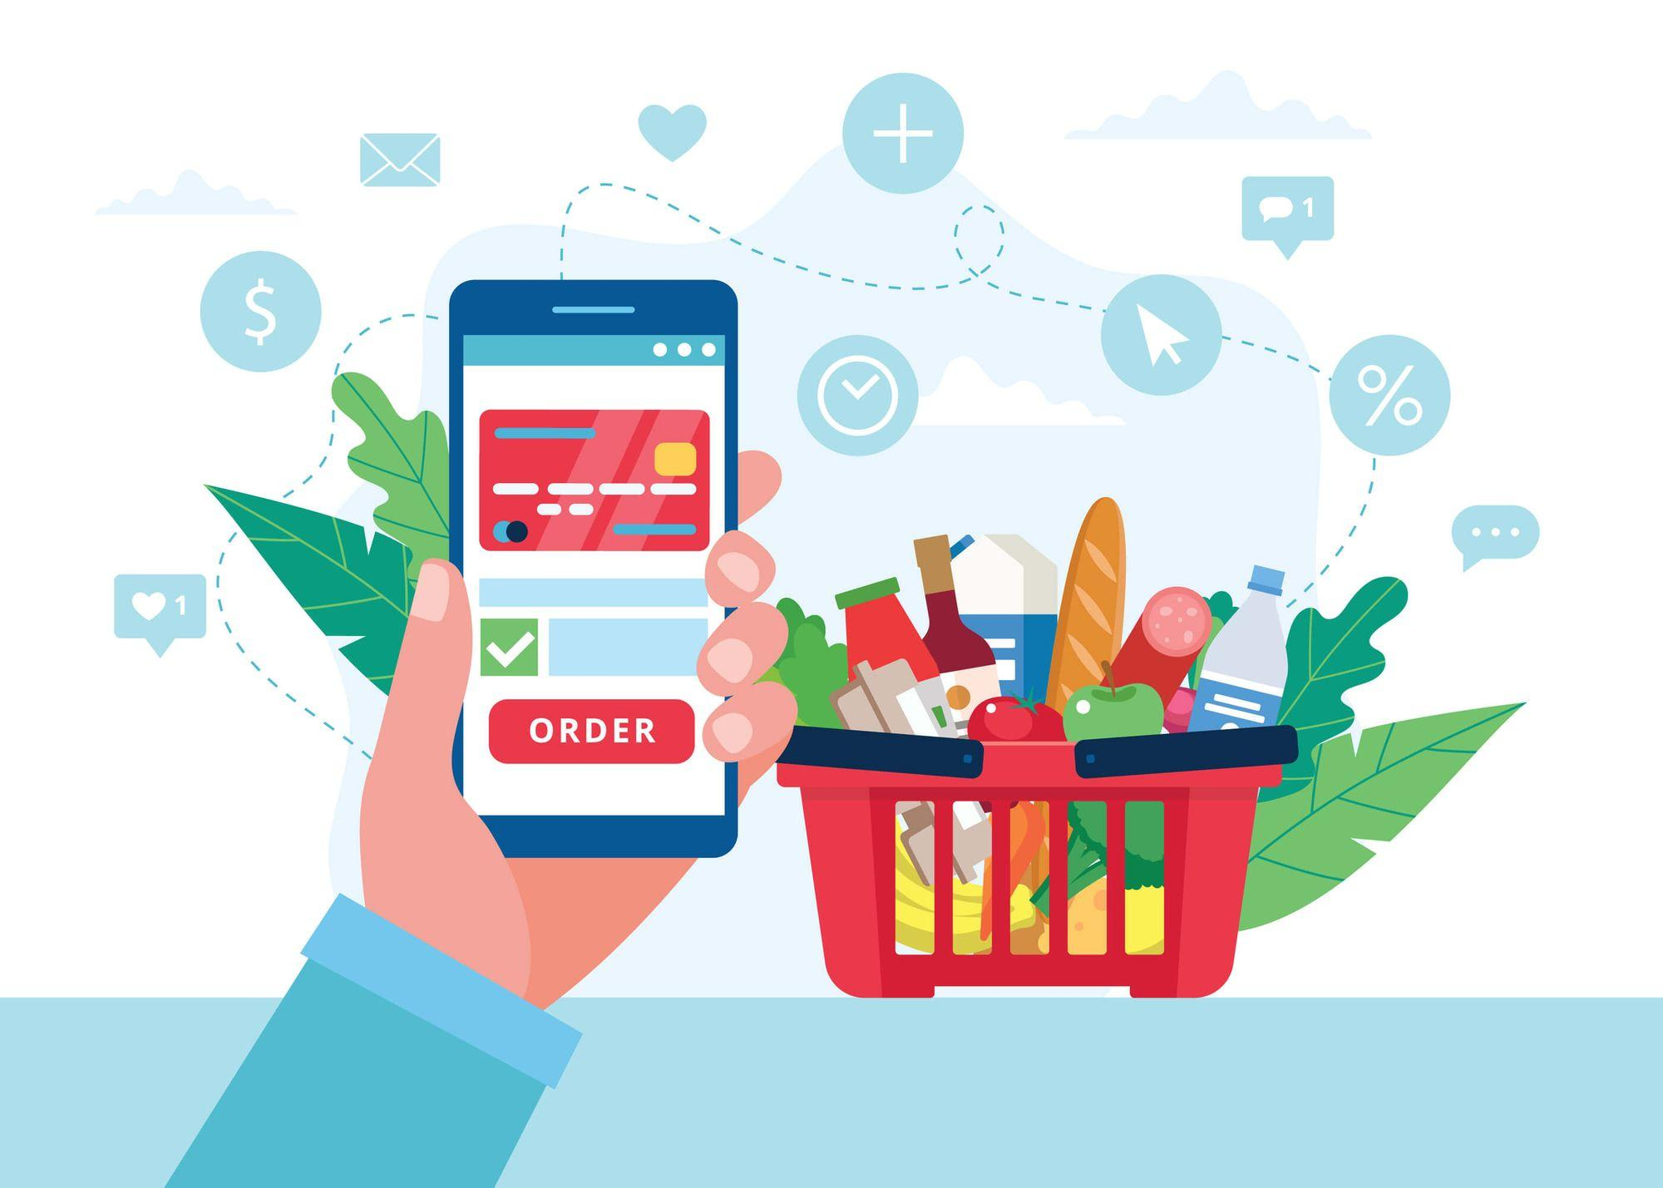
After the onset of COVID-19, grocery apps have been the most preferred mode of grocery shopping.
Credit/Debit cards are the most preferred payment mode and Digital Wallets is the least preferred.
On the whole, respondents had a positive outlook on online grocery shopping and a majority claimed to continue shopping online post pandemic.

Slide 46
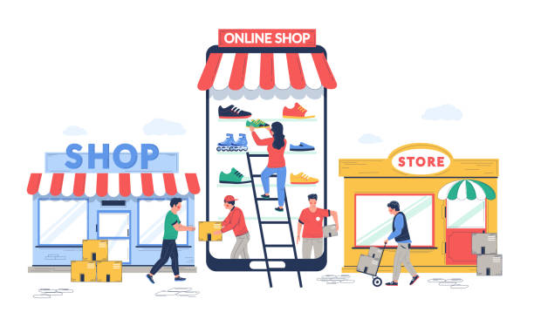
FUTURE OF GROCERY SHOPPING
With E-commerce in India being one of the most dynamically growing industry owing to internet penetration, and consumer’s lifestyle changes, online grocery shopping has emerged to be one of the strongest subset of the retail sector.
Online grocery shopping goes hand in hand with offline shopping and is regarded as a more technically advanced pastime.

Slide 47

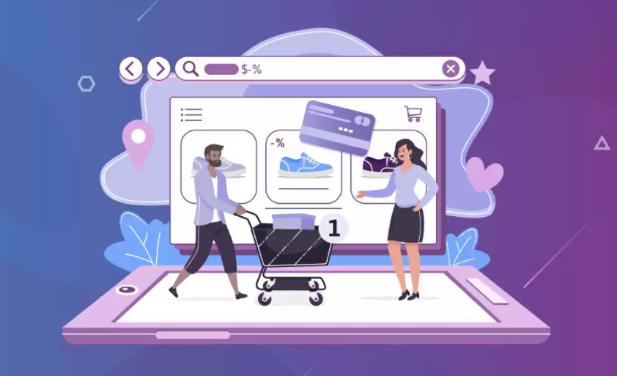
RECOMMENDATIONS
Guided discovery and product recommendations
Responsive and simple
web design
Eliminate check out distractions

Slide 48


RECOMMENDATIONS
Live chat and customer support
Do not force Sign-up
Strong marketing

Slide 49

Thank You
By-
Ananya Pandey
Biyyala Shirisha
Pampati Sreya

